Slide 1
Day13 容器进阶之Kubernetes 安全原理分析

Slide 2
大 纲
安全全景图
认证和鉴权
Admissions与安全的持久化保存键值(etcd)
Pod SecurityContext（安全上下文）
Network Policy

Slide 3
安全全景图
部署态的安全控制
认证
鉴权
Admission（准入控制）
Pod SecurityContext
运行态的安全控制
Network policy

Slide 4
认证(Authentication)和鉴权(Authorization)
// Info describes a user that has been authenticated to the system.
type Info interface {
// GetName returns the name that uniquely identifies this user among all
// other active users.
GetName() string
// GetUID returns a unique value for a particular user that will change
// if the user is removed from the system and another user is added with
// the same name.
GetUID() string
// GetGroups returns the names of the groups the user is a member of
GetGroups() []string
// GetExtra can contain any additional information that the authenticator
// thought was interesting. One example would be scopes on a token.
// Keys in this map should be namespaced to the authenticator or
// authenticator/authorizer pair making use of them.
// For instance: "example.org/foo" instead of "foo"
// This is a map[string][]string because it needs to be serializeable into
// a SubjectAccessReviewSpec.authorization.k8s.io for proper authorization
// delegation flows
// In order to faithfully round-trip through an impersonation flow, these keys
// MUST be lowercase.
GetExtra() map[string][]string
}
认证支持多种方式，其中一种认证方式认证通过即通过，输出userinfo
基于认证输出的userinfo进行鉴权，鉴权也支持多种方式，常用方式为RBAC

Slide 5
认证(Authentication)
认证方式有：X509、service account、Authenticating Proxy、WebHook、username/password…
常用认证方式介绍：
X509：
Kube-apiserver的启动参数’—client-ca-file=ca.crt’指定X509根证书，请求中需带有由该根证书签名的证书，才能认证通过
客户端签署的证书里包含user、group信息，具体为证书的subject.CommonName（user name）以及subject.Organization（group）

Slide 6
认证(Authentication)
Service Account（为k8s必选认证方式）：
Kube-apiserver的启动参数’—service-account-key-file=key.pem’指定pem文件，用以生成bearer token；’—service-account-lookup=true/false’表示在删除service account后其token是否被吊销
Serviceaccount Admission默认给Pod打上service account，当然用户也可以自行指定所需要的service account
spec:
serviceAccountName: default
containers:
- image: nginx:latest
imagePullPolicy: IfNotPresent
name: container-0
volumeMounts:
- mountPath: /var/run/secrets/kubernetes.io/serviceaccount
name: default-token-rm7xw
readOnly: true
volumes:
- name: default-token-rm7xw
secret:
defaultMode: 420
secretName: default-token-rm7xw

Slide 7
kind: Role
apiVersion: rbac.authorization.k8s.io/v1
metadata:
namespace: default
name: pod-reader
rules:
- apiGroups: [""] # "" indicates the core API group
resources: ["pods"]
verbs: ["get", "watch", "list"]
---
kind: ClusterRole
apiVersion: rbac.authorization.k8s.io/v1
metadata:
name: secret-reader
rules:
- apiGroups: [""] # "" indicates the core API group
resources: [“secrets"]
verbs: ["get", "watch", "list"]
鉴权(Authorization)
鉴权分为以下几种：RBAC、ABAC、Node以及Webhook
常用RBAC介绍：
kind: RoleBinding
apiVersion: rbac.authorization.k8s.io/v1
metadata:
namespace: default
name: read-pods
subjects:
- kind: User
name: wangbo
apiGroup: rbac.authorization.k8s.io/v1
roleRef:
kind: Role #this can be Role or ClusterRole
name: pod-reader
apiGroup: rbac.authorization.k8s.io/v1
---
kind: ClusterRoleBinding
apiVersion: rbac.authorization.k8s.io/v1
metadata:
name: read-secrets-global
subjects:
- kind: Group
name: manager
apiGroup: rbac.authorization.k8s.io/v1
roleRef:
kind: ClusterRole #this must be ClusterRole
name: secret-reader
apiGroup: rbac.authorization.k8s.io/v1

Slide 8
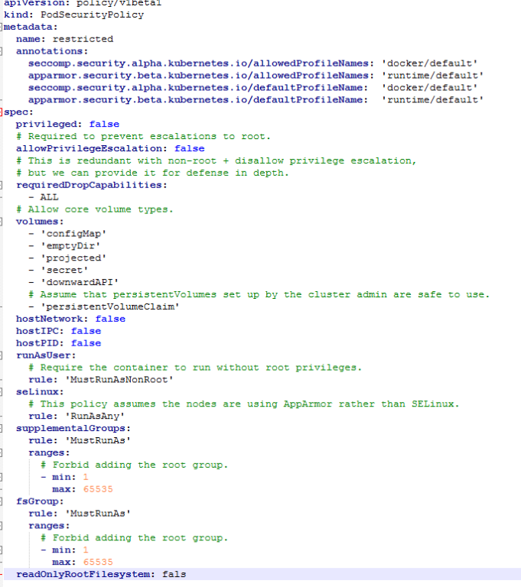
Admission(PodSecurityPolicy)
Kube-apiserver的启动参数’—admission-control=PodSecurityPolicy’新增PodSecurityPolicy admission
Admin用户创建PodSecurityPolicy策略，决定能创建什么样的Pod
创建Pod的用户也必须赋予它能使用PodSecurityPolicy策略的权限

Slide 9
安全的持久化保存键值（etcd）
etcd支持备份恢复机制，防止数据被误删导致数据丢失
用户的敏感信息建议存放在secret类型的资源中，该类型资源是加密存储在etcd中
etcd支持https，kube-apiserver访问etcd使用https协议
具体配置方式：
Client->Server:
--cert-file=<path>
--key-file=<path>
通道以tls协议加密
--------------------
--client-cert-auth
--trusted-ca-file=<path>
服务端会认证客户端证书是否
是受信任CA签发
--------------------
--auto-tls
是否系统自动生成证书
Server->Server:
--peer-cert-file=<path>
--peer-key-file=<path>
通道以tls协议加密
--------------------
--peer-client-cert-auth
--peer-trusted-ca-file=<path>
服务端会认证客户端证书是否
是受信任CA签发
--------------------
--peer-auto-tls
是否系统自动生成证书

Slide 10
安全上下文（Pod SecurityContext）
分为Pod级别和容器级别，容器级别的会覆盖Pod级别的相同设置。
在有PodSecurityPolicy策略的情况下，两者需要配合使用
apiVersion: v1
kind: Pod
metadata:
name: wangbo
spec:
securityContext:
privileged: false
runAsUser: 1000
fsGroup: 2000
volumes:
- name: test
emptyDir: {}
containers:
- name: test
image: gcr.io/google-samples/node-hello:1.0
volumeMounts:
- name: test
mountPath: /data/test
securityContext:
readOnlyRootFilesystem: false
runAsUser: 1001
privileged: false
capabilities:
add: ["NET_ADMIN", "SYS_TIME"]
drop: ["SYS_BOOT"]
是否使用特权容器
指定容器启动UID
指定Pod中容器文件所属组GID
容器的文件系统是否是只读
容器系统调用能力配置

Slide 11
Network Policy
apiVersion: networking.k8s.io/v1
kind: NetworkPolicy
metadata:
name: test-network-policy
namespace: default
spec:
podSelector:
matchLabels:
role: db
policyTypes:
- Ingress
- Egress
ingress:
- from:
- ipBlock:
cidr: 172.17.0.0/16
except:
- 172.17.1.0/24
- namespaceSelector:
matchLabels:
project: myproject
- podSelector:
matchLabels:
role: frontend
ports:
- protocol: TCP
port: 6379
egress:
- to:
- ipBlock:
cidr: 10.0.0.0/24
ports:
- protocol: TCP
port: 5978
分为Ingress和Egress策略控制，都为白名单
Ingress为入口请求控制
Egress为出口请求控制
规则匹配器，选择匹配的Pod
远端（访问端）IP白名单开放
远端（访问端）namespace白名单开放
远端（访问端）pod白名单开放
本端（被访问端）允许被访问的端口和协议

Slide 12
Network Policy
允许所有入口请求
apiVersion: networking.k8s.io/v1
kind: NetworkPolicy
metadata:
name: allow-all
spec:
podSelector: {}
policyTypes:
- Ingress
ingress:
- {}
禁止所有入口请求
apiVersion: networking.k8s.io/v1
kind: NetworkPolicy
metadata:
name: default-deny
spec:
podSelector: {}
policyTypes:
- Ingress
允许所有出口请求
禁止所有出口请求
apiVersion: networking.k8s.io/v1
kind: NetworkPolicy
metadata:
name: default-deny
spec:
podSelector: {}
policyTypes:
- Egress
egress：
- {}
apiVersion: networking.k8s.io/v1
kind: NetworkPolicy
metadata:
name: default-deny
spec:
podSelector: {}
policyTypes:
- Egress

Slide 13
Thank You

